Slide 1
SAMARITAN INTERNATIONAL
AVEC Kick-off conference 2013
Citizens‘ participation in European politics
International exchange for mutual learning and innovative solutions
Adeline Otto
Berlin, 22 August 2013

Slide 2
I. The complexity of EU policy-making
diverse Ideas
various Interests
complex Interactions
multiple Institutions

Slide 3
1. Institutions and Interactions
Institutional structure of the EU
  Unique institutional framework (multi-level, horizontally complex)
  Evolving and “incomplete federalism“ with division of competences and spillover effects in policy areas and between regions
  Puzzling policy approach between path dependency and policy preferences
Policy debates and processes in the EU
  Every increasing diversity; extremely dynamic and volatile
  Use of financial incentives, strengthened economic governance and exchange on „best practices“ to influence policy developments
  Not necessarily coordinated and integrated
  Extensive opportunities to get involve
  Semi-transparent

Slide 4
2. Ideas and Interest Groups
Ideas, values or norms (some examples related to social and employment affairs)
  Purely economic >< social and value-based economic activity
  Liberalisation, privatisation and deregulation >< protectionism and market regulation
  Solidarity >< individual freedom of choice
  Economic interest >< general interest
  Social investment >< social spending and transfer state
  Self-responsibility >< societal responsibility and public support
Interest groups
  E.g. National governments, parties, industry, professions, employers‘ representations and trade unions, NGOs, Third Sector, foundations, think tanks, consultancies (in their different forms of organisation)

Slide 5
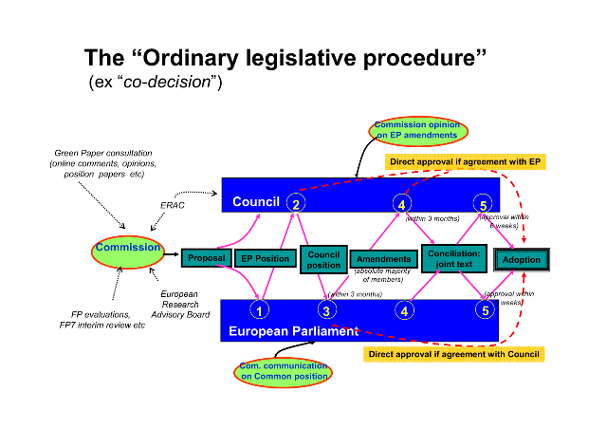
3. EU politics: COD in practice

Slide 6
4. Participate in EU politics
Not-institutionalised
Solid relationships with policy-makers at national level
Regular contact and exchange with the EU institutions
  tools: advocacy work, exchanges, meetings, conferences, position papers, amendments, EP initiative reports, studies, progress/assessment/field reports etc.
European networking, activism, campaigns and projects
Social Media
Institutionalised
European Citizen Initiative
European Semester
(social) OMC
annual conventions etc.

Slide 7
5. Advocacy work (1/3)
Monitor – what is happening in the institutions? Which new policy trends and legislative proposals?
Analyse – what could this mean for your member organisation and target group? What actions are needed?
Raise awareness – ensure that your members understand the implications for them and their concerns
Engage – encourage debate, exchange of ideas, brainstorm on objectives and action points
Consult – gather viewpoints from communities and target groups concerned by the policy

Slide 8
5. Advocacy work (2/3)
Challenge – policy-makers and other stakeholders to address your concerns or provide evidence and arguments for your position
Empower – provide the tools for your partners and networks to act (e.g. draft letters, petitions, round tables etc.)
Represent – bringing forward the diversity of voices of civil society, public interest, visibility through media
Follow-up – keep up the momentum, follow the policy to implementation, evaluation and review

Slide 9
5. Advocacy work (3/3)
advocacy
Planning & Coordination
Lobbying
Research
Alliance Building
Activism
Publicity
Policy Analysis
Strategy
Matched to internal resources
Based on your values and realities
SWOT analysed; clear, focused and coherent
Resources
People with skills, knowledge and commitment
Funds, facility, equipment
Reputation, relationships, support
Integrated, coodinated and decisive structure

Slide 10
II. EU-SAM.I: a vertical counterflow process
EU-level
SAM.I members‘ interests and ideas
National level
EU-decisions and opportunities

Slide 11
1. SAM.I - EU
Your added value to EU politics
Social and humanistic values, principles, ideas
Long-standing practice and experience, strong expertise, knowledge and evidence on what works
Solid internal structures + partnerships; Extensive networks
Placing your beneficial capacities
Develop resources to know/monitor/analyse EU rules and regulations
Influence processes and decisions through advocacy work and projects; enhance knowledge and evidence transfer of policies/practices on the national level
Strengthen cooperation and exchange through networking

Slide 12
2. EU-SAM.I
Institutional
More or less coordinated policy framework that is still evolving
EU financial support (Structural Funds, policy initiatives; network, project and research budget)
EU networks and alliances for broader cooperation
Interactions and Interest (groups)
Influenceable policy processes (to limited extent)
Enormous opportunities for cooperation and exchange within formal and informal networks
Ideas
New ideas challenging own ideas and practices but also opportunities for mutual learning

Slide 13
III. Horizontal exchange
Other social service providers and volunteering organisations
Wider social networks and NGOs
Think tanks, foundations etc.
European networks and platforms
International network and platforms
The world of research

Slide 14
1. Reasons for civil society to network across own boundaries
Practical: better access to information; status and attractiveness for donors and policy-makers, economies of scale, shared negotiating power
Ideological: promote your ideas and values; solidarity for smaller organisations; building common guidelines, methodologies or quality standards, unified voice of coherence for civil society
Pragmatic: raised visibility of common issues, sharing experiences, contacts and ideas, common lobbying platform, multiplier effect; better representation of interests; reducing risks and avoiding duplications

Slide 15
2. Cooperation between civil society organisations and research
Participatory and community-based research that builds living knowledge into academic knowledge
Enhancing the relevance and validity of research results
Improving access to data and the field studied (e.g. at-risk groups)
Tap into other forms of knowledge and expertise for a co-construction of knowledge
Better identification of research gaps
Capacity-building for CSOs
Improved policy-making

Slide 16
CONTACT
Adeline Otto School of Social Policy,
Research Associate Sociology and Social
      Research
E: a.otto@kent.ac.uk University of Kent
T: +44 (0) 1227 82 7295 Cornwallis North East
Skype: a.otto.kent Canterbury
www.kent.ac.uk/sspssr/ Kent CT2 7NF
United Kingdom

